Slide 1
International Image Interoperability Framework*
* Now with AV!
Andy Irving, British Library

Slide 2
A model for presenting and annotating digital representations of objects
(with lots of other benefits)

Slide 3
A Community
that develops shared APIs,
implements them in software,
and exposes interoperable content
Notes:
A community that develops sghared APIs, implements them in software, and exposes interoperable content

Slide 4
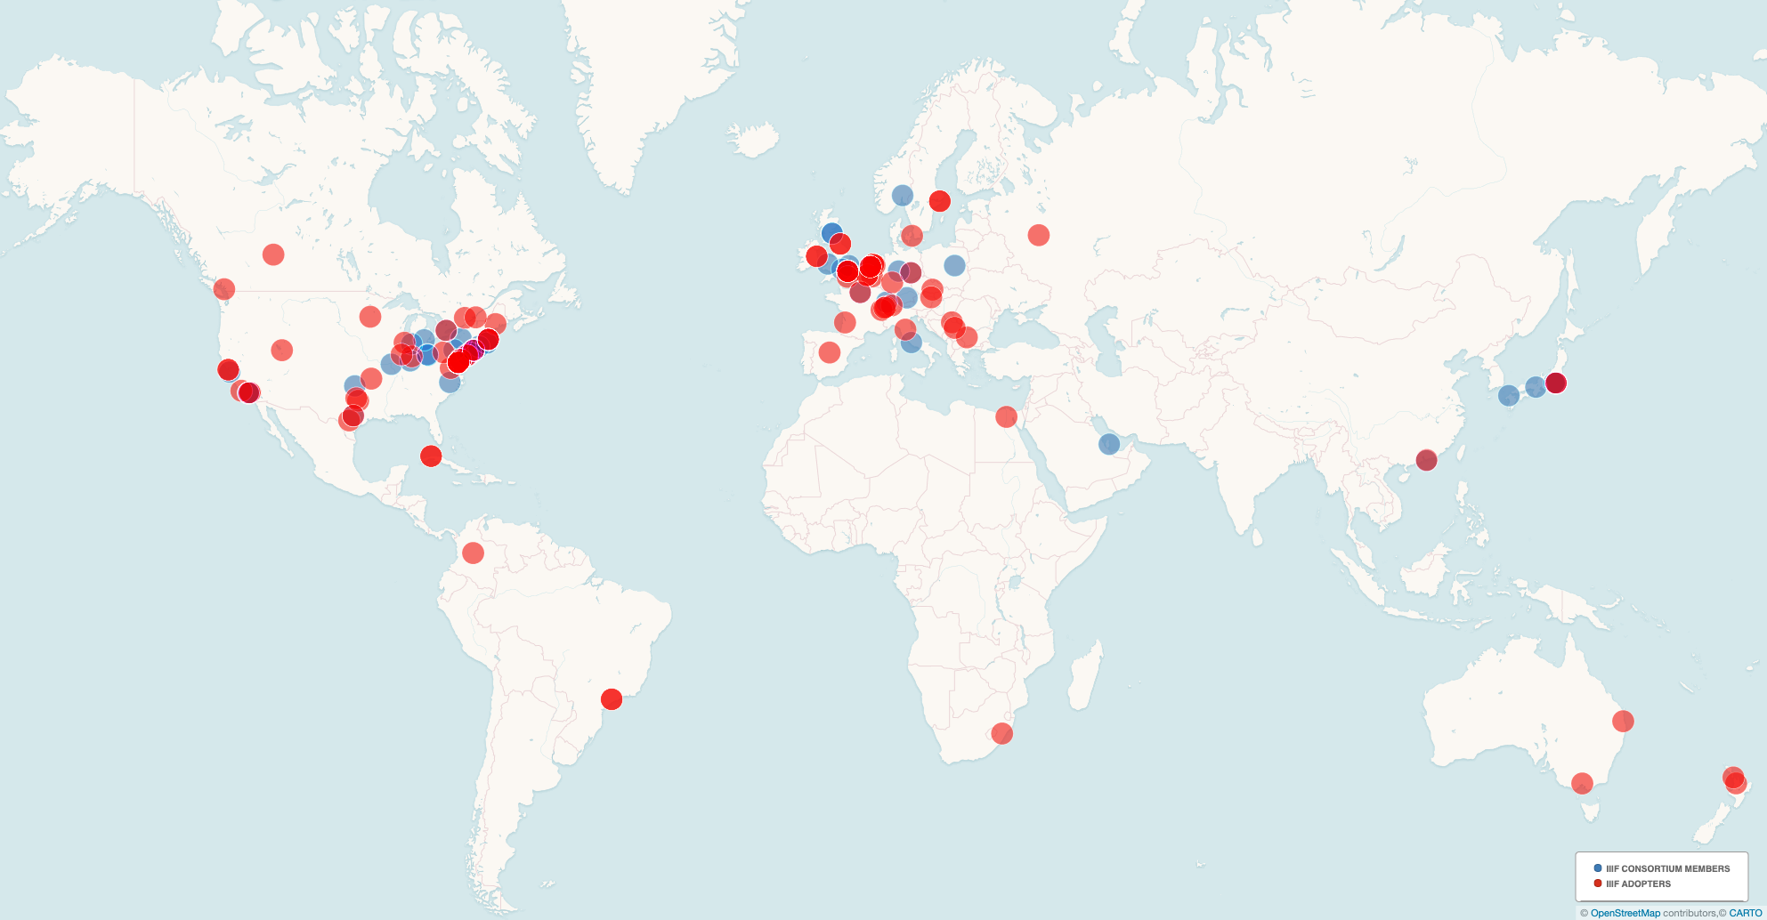
A Global Community
Notes:
This is out of date! Blue are consortium members, red adopters (that we know about)

Slide 5
Why IIIF AV?
Can we do for time-based media what IIIF already does for images and things made up of images?
Describe complex AV works in an interoperable way, via a manifest
Access, viewing
Annotation
Search…
Use IIIF to present time-based media consistently with image-based objects
Benefit from same IIIF mechanisms for linking, metadata, content search, access control

Slide 6
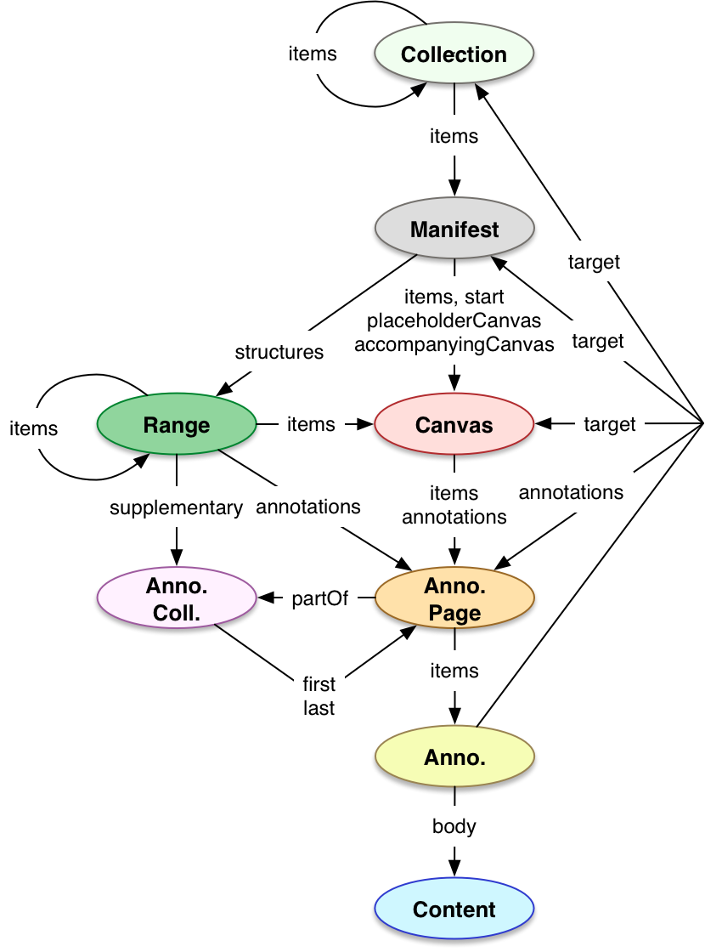
IIIF Presentation API
Collection & Manifest are just units of distribution
Canvas describes an abstract space
Annotations all the way down
Range describes structure
Notes:
Collection being a collection of manifests
Manifest is the unit of distribution (say, a Book or an Album)
Canvas described an abstract space, think a page or a side of a record
Ranges describe structure (e.g. chapters of a book, tracks on a tape)

Slide 7
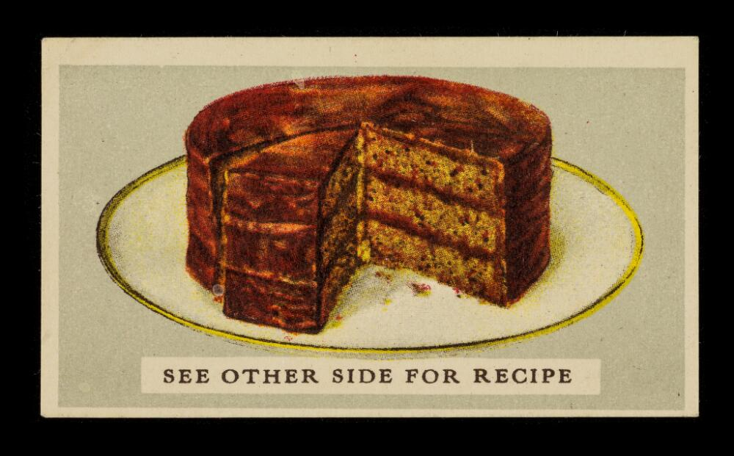
For all that image and text content, we do this by assembling content on a 2D Canvas:
(0,0)
SEE OTHER SIDE FOR RECIPE
(3110, 2102)
Notes:
A canvas is an abstract space with some dimensions to set an aspect ratio.
This space doesn’t have any content yet. How do we fill it? Through annotation.

Slide 8
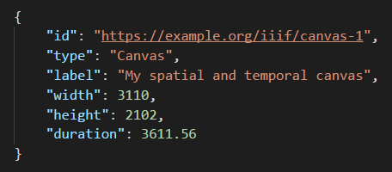
Canvases can now have duration
(0,0)
🕐
(3110, 2102)
Notes:
Now, canvases can have a duration. So you can have width/height and duration, or just just width/height, or just duration!

Slide 9
What does that mean?
It means the simplest (and most common) use case…
Just play the audio
Just play the video
…is as easy as its 2D equivalent – one image of a painting, etc.
The content just fills the canvas time – the duration.
But we also have the same toolkit for complex content association and description.
And we NEED IT!

Slide 10
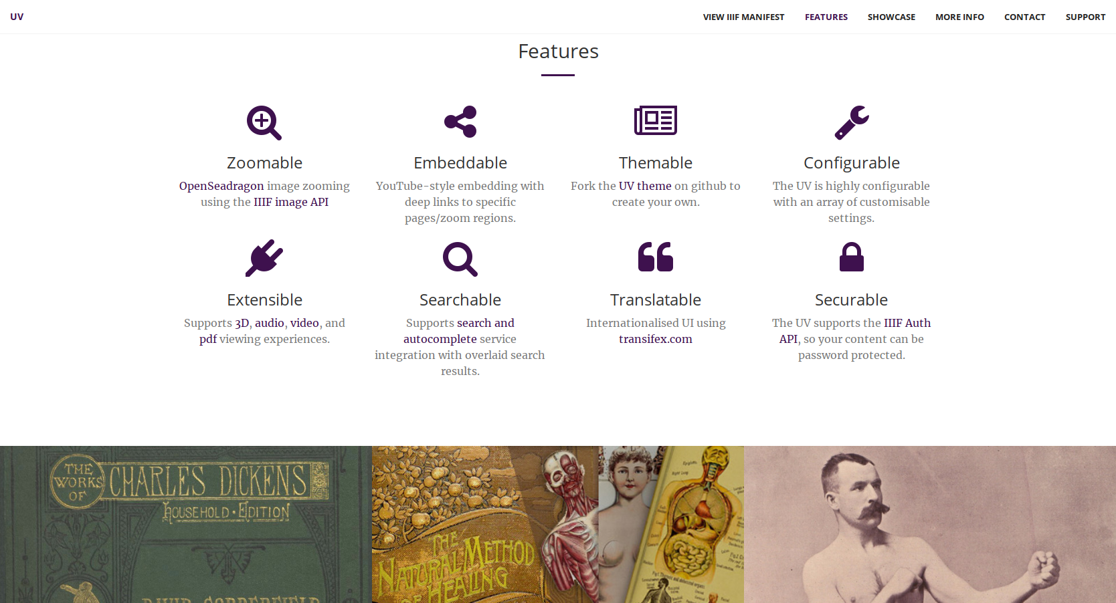
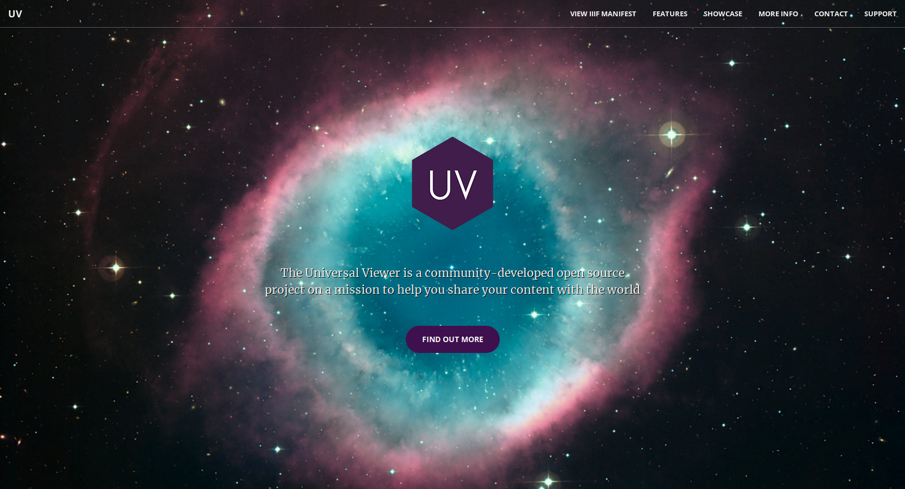

Slide 11
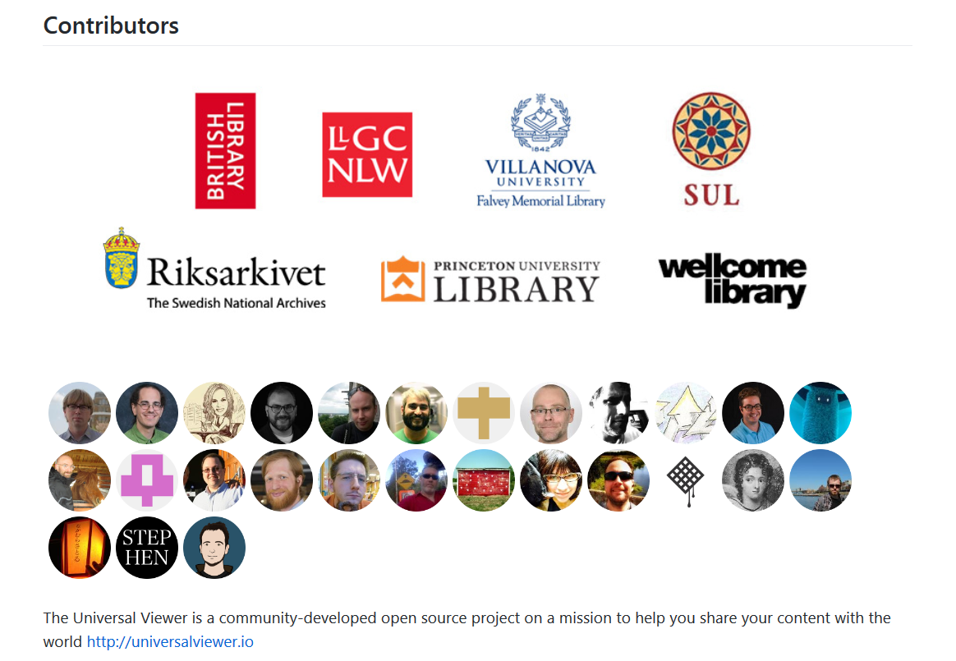
Notes:
The UV is open source, and has contributions from these handsome devils
As well as institutional support in the form of developers, testers or sometimes just cash

Slide 12
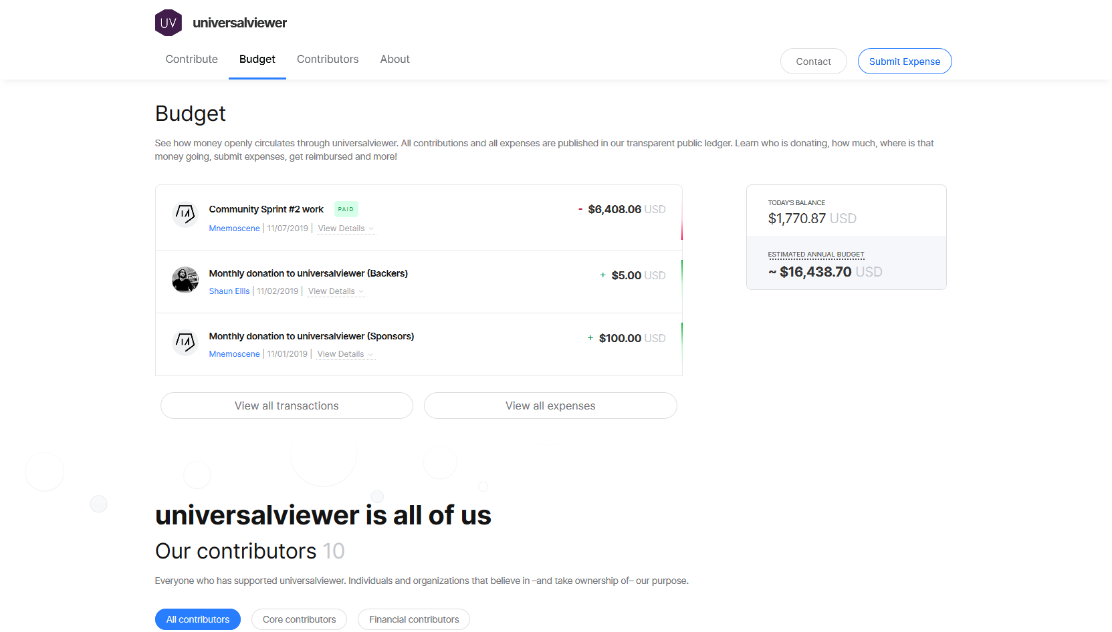
Notes:
Some of us also pay into a community fund for UV

Slide 13
Say hello to my friend Ed
Lead developer of the Universal Viewer
Also wrote a helpful tool

Slide 14
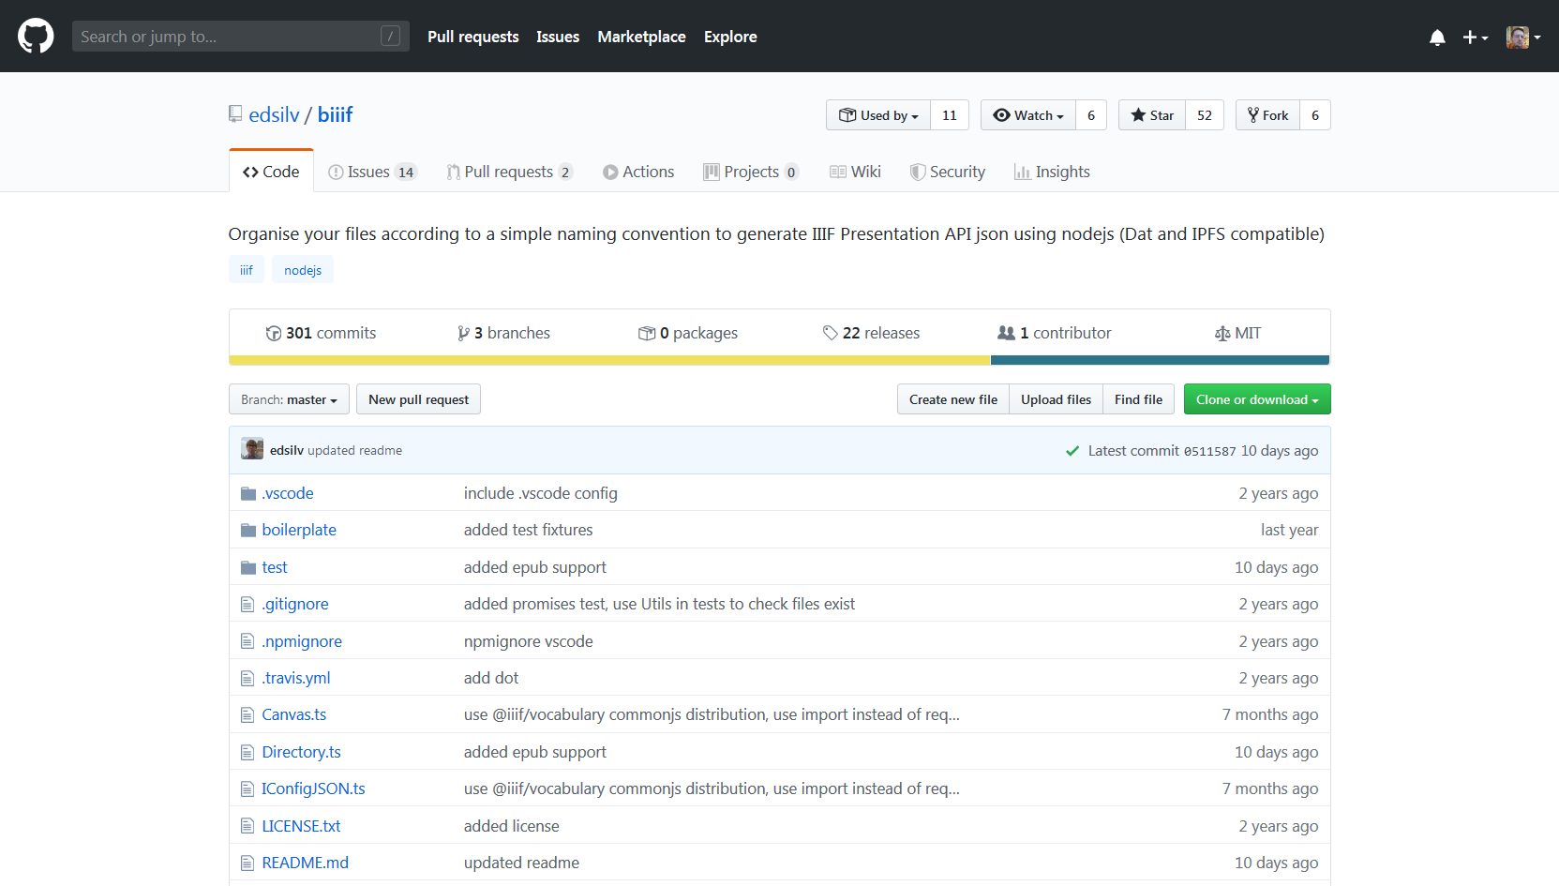
biiif!
Notes:
I’ll be using the biiif-cli tool to make these examples if you want to try this out yourself (and you should!)
https://github.com/edsilv/biiif

Slide 15
Scenario 1: Should be a cakewalk
I HAVE AN ACCESS COPY OF MY VIDEO
Copyright? YOLO!
Notes:
EIther i’m so confident this material is cleared OR I don’t care… or maybe it’s just available internally?

Slide 16
Notes:
Using a tiny bit of boilerplate, we put the video we want to make available into a folder beginning with an underscore
We can add some basic metadata into an info.yml file
Then we just need a url path to use as the base for everything
And we get some nice IIIF presentation API 3.0 output

Slide 18
Scenario 2: I don’t want to get sued
Hey, aren’t closed captions great?
Notes:
If you’re from the USA then this applies to you!
Of course, we should provide captions for accessibility reasons.
And we can!

Slide 19
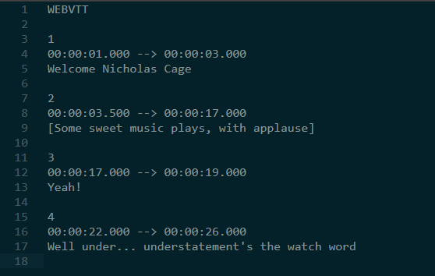
Notes:
The great thing about the IIIF Presentation API is that it’s all about annotating!
So we can just annotate web VTT as text onto the same time line
We do this by putting the vtt file in the same directory as the video

Slide 20
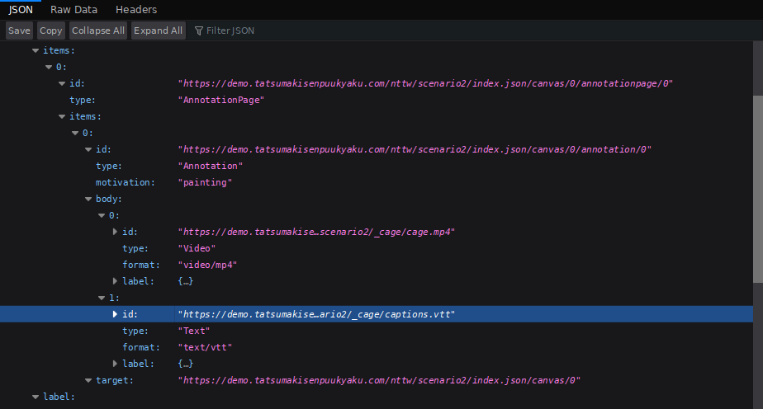
Notes:
It’s all just annotations

Slide 21
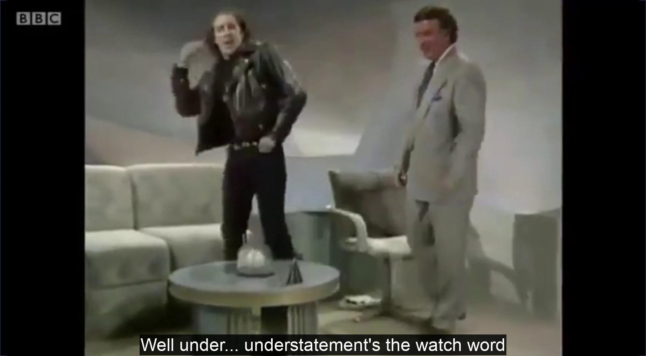
Notes:
Using a different viewer to highlight our great interoperability credentials!
http://kankazi.com
Written by Kanzaki Masahide

Slide 22
Scenario 3: Behold my beautiful metadata
Clips are easy and this isn’t better than youtube or vimeo, is it?
Notes:
Once nice thing about the presentation API is it allows you to create structure.
Obviously this is helpful with digitised books, as you can group images into chapters, etc
And you can do the same for AV

Slide 23
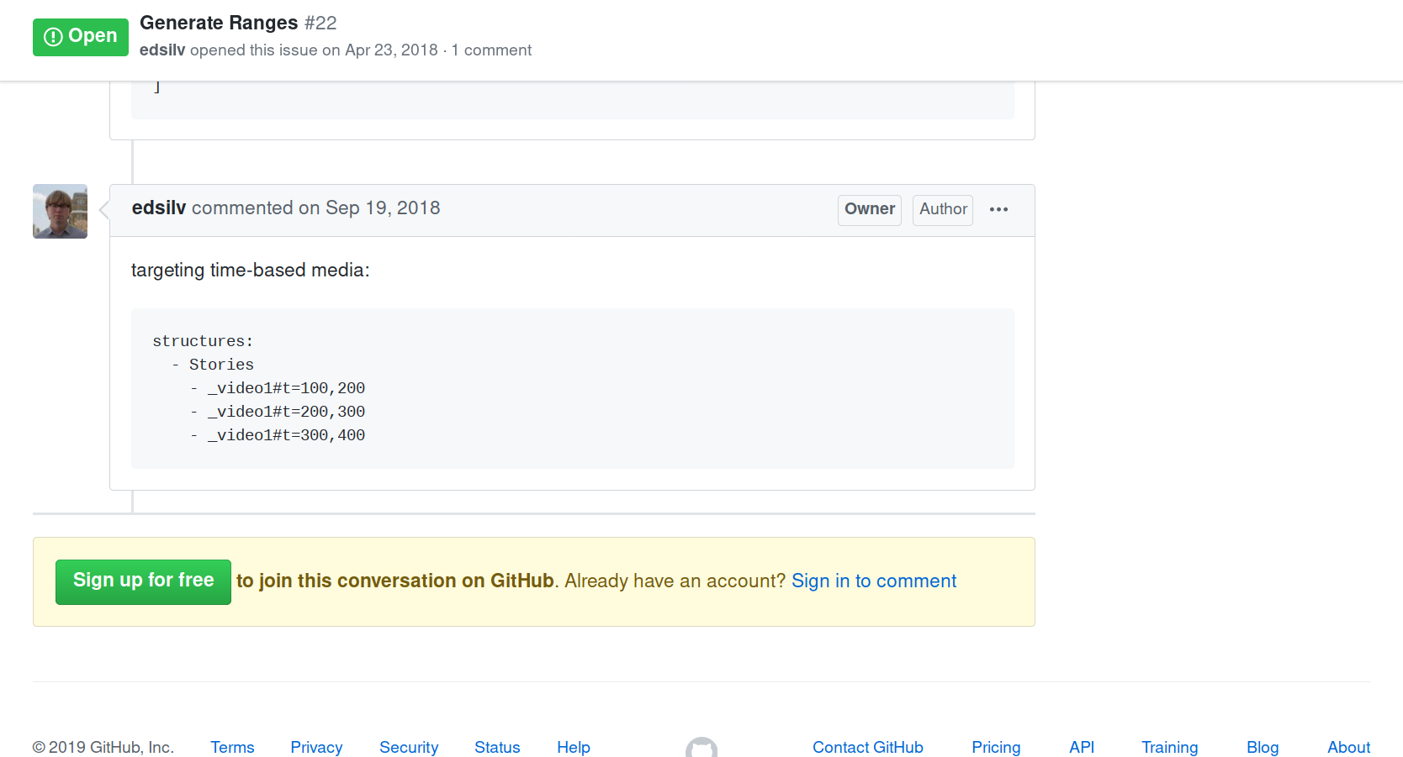
Notes:
Full disclosure, this feature isn’t released in biiif yet!

Slide 24
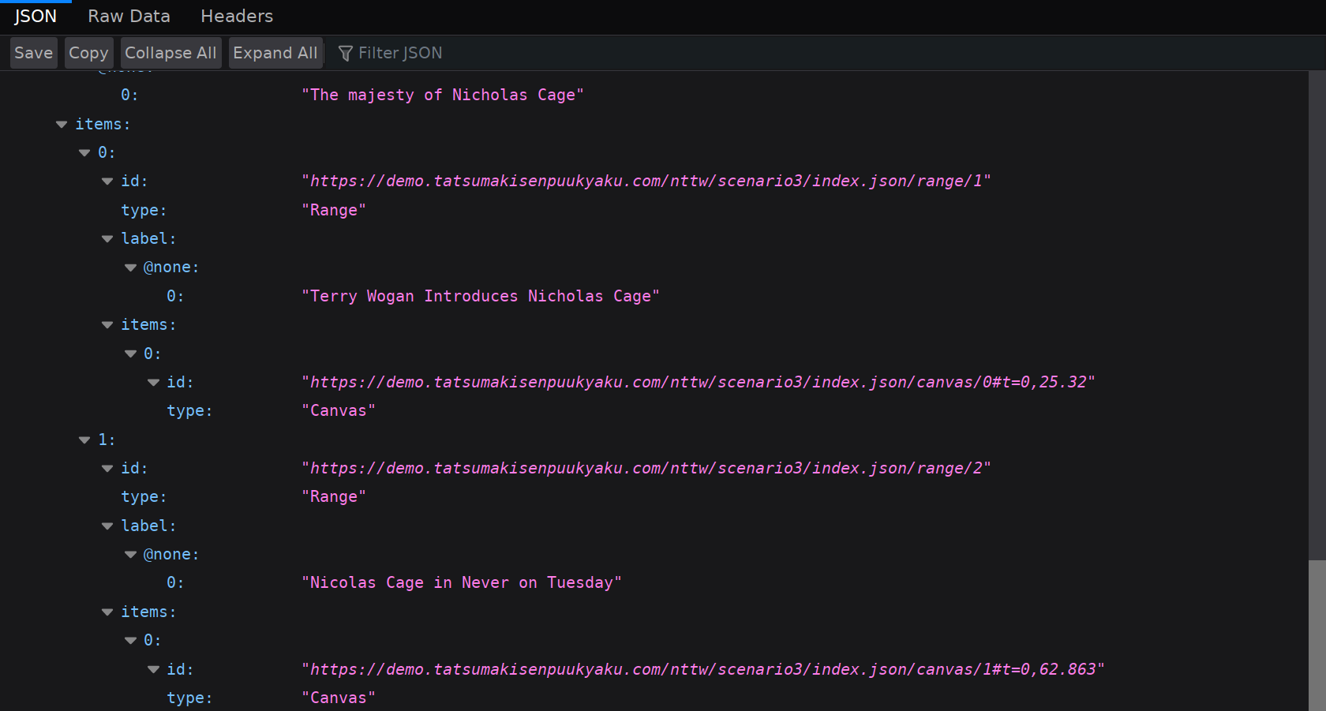
Notes:
So you can create another underscore folder with another video in and here’s how it let’s you build a table of contents, using the time fragment to target specific durations

Slide 25
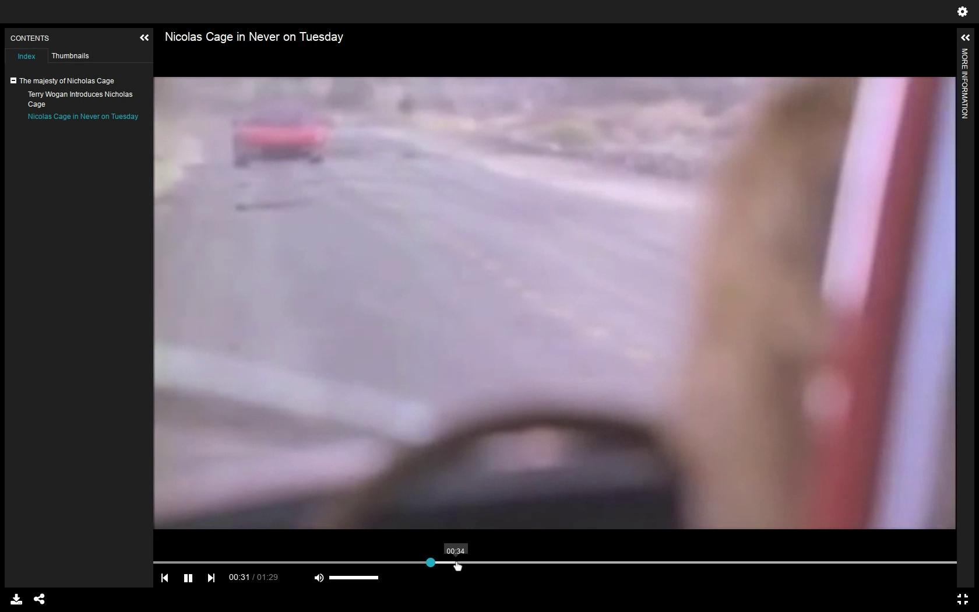
Notes:
Here i’ve combined it into one long timeline but you don’t have to

Slide 26
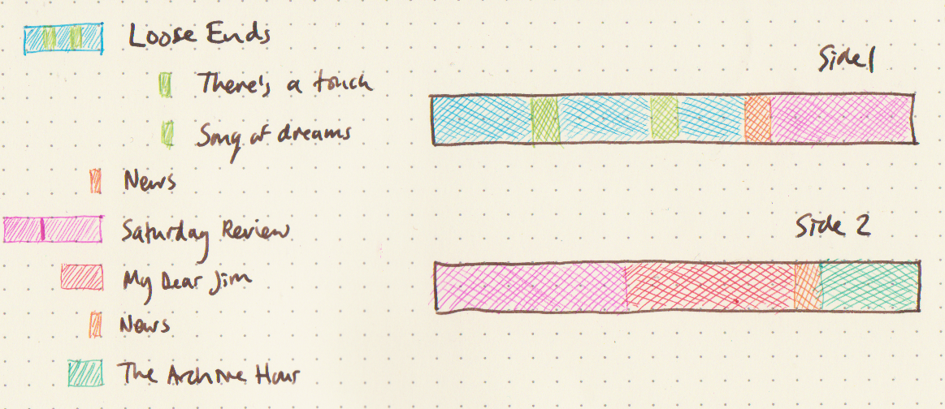
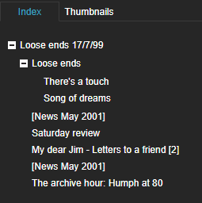
You can always go “Full BL”
Notes:
A real world modelling problem here, with each side of a tape being digitised to one file.
Logical sections of the recording span the sides

Slide 27
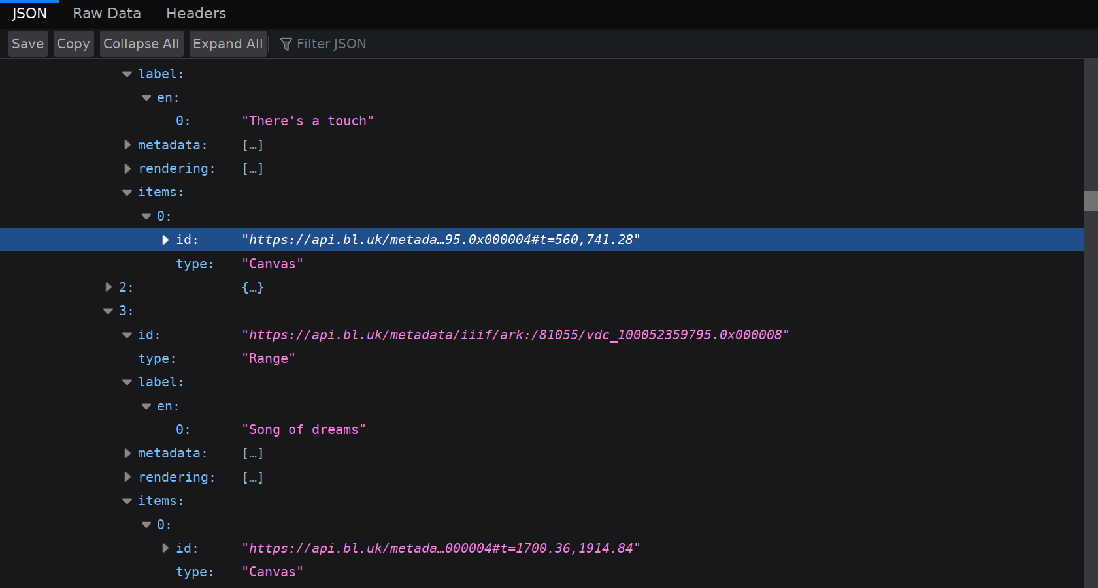
Notes:
We can target the canvas using

Slide 28
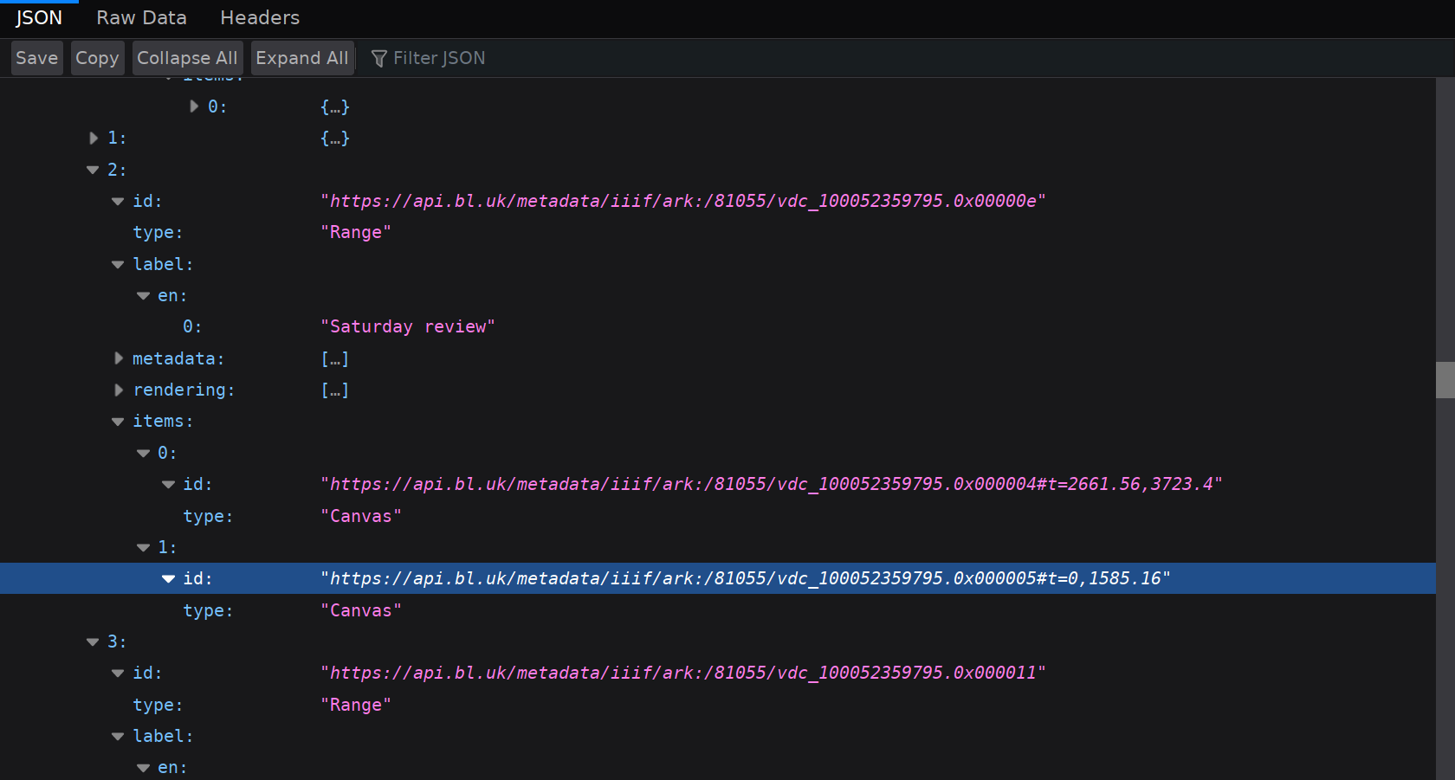
Notes:
And here we target two time ranges across two canvases.
So you can build pretty complex logical heirarchies

Slide 29
Scenario 4: I don’t want to get sued, part 2
Probably not a great idea to make this open access without rights clearing it first, eh?

Slide 30
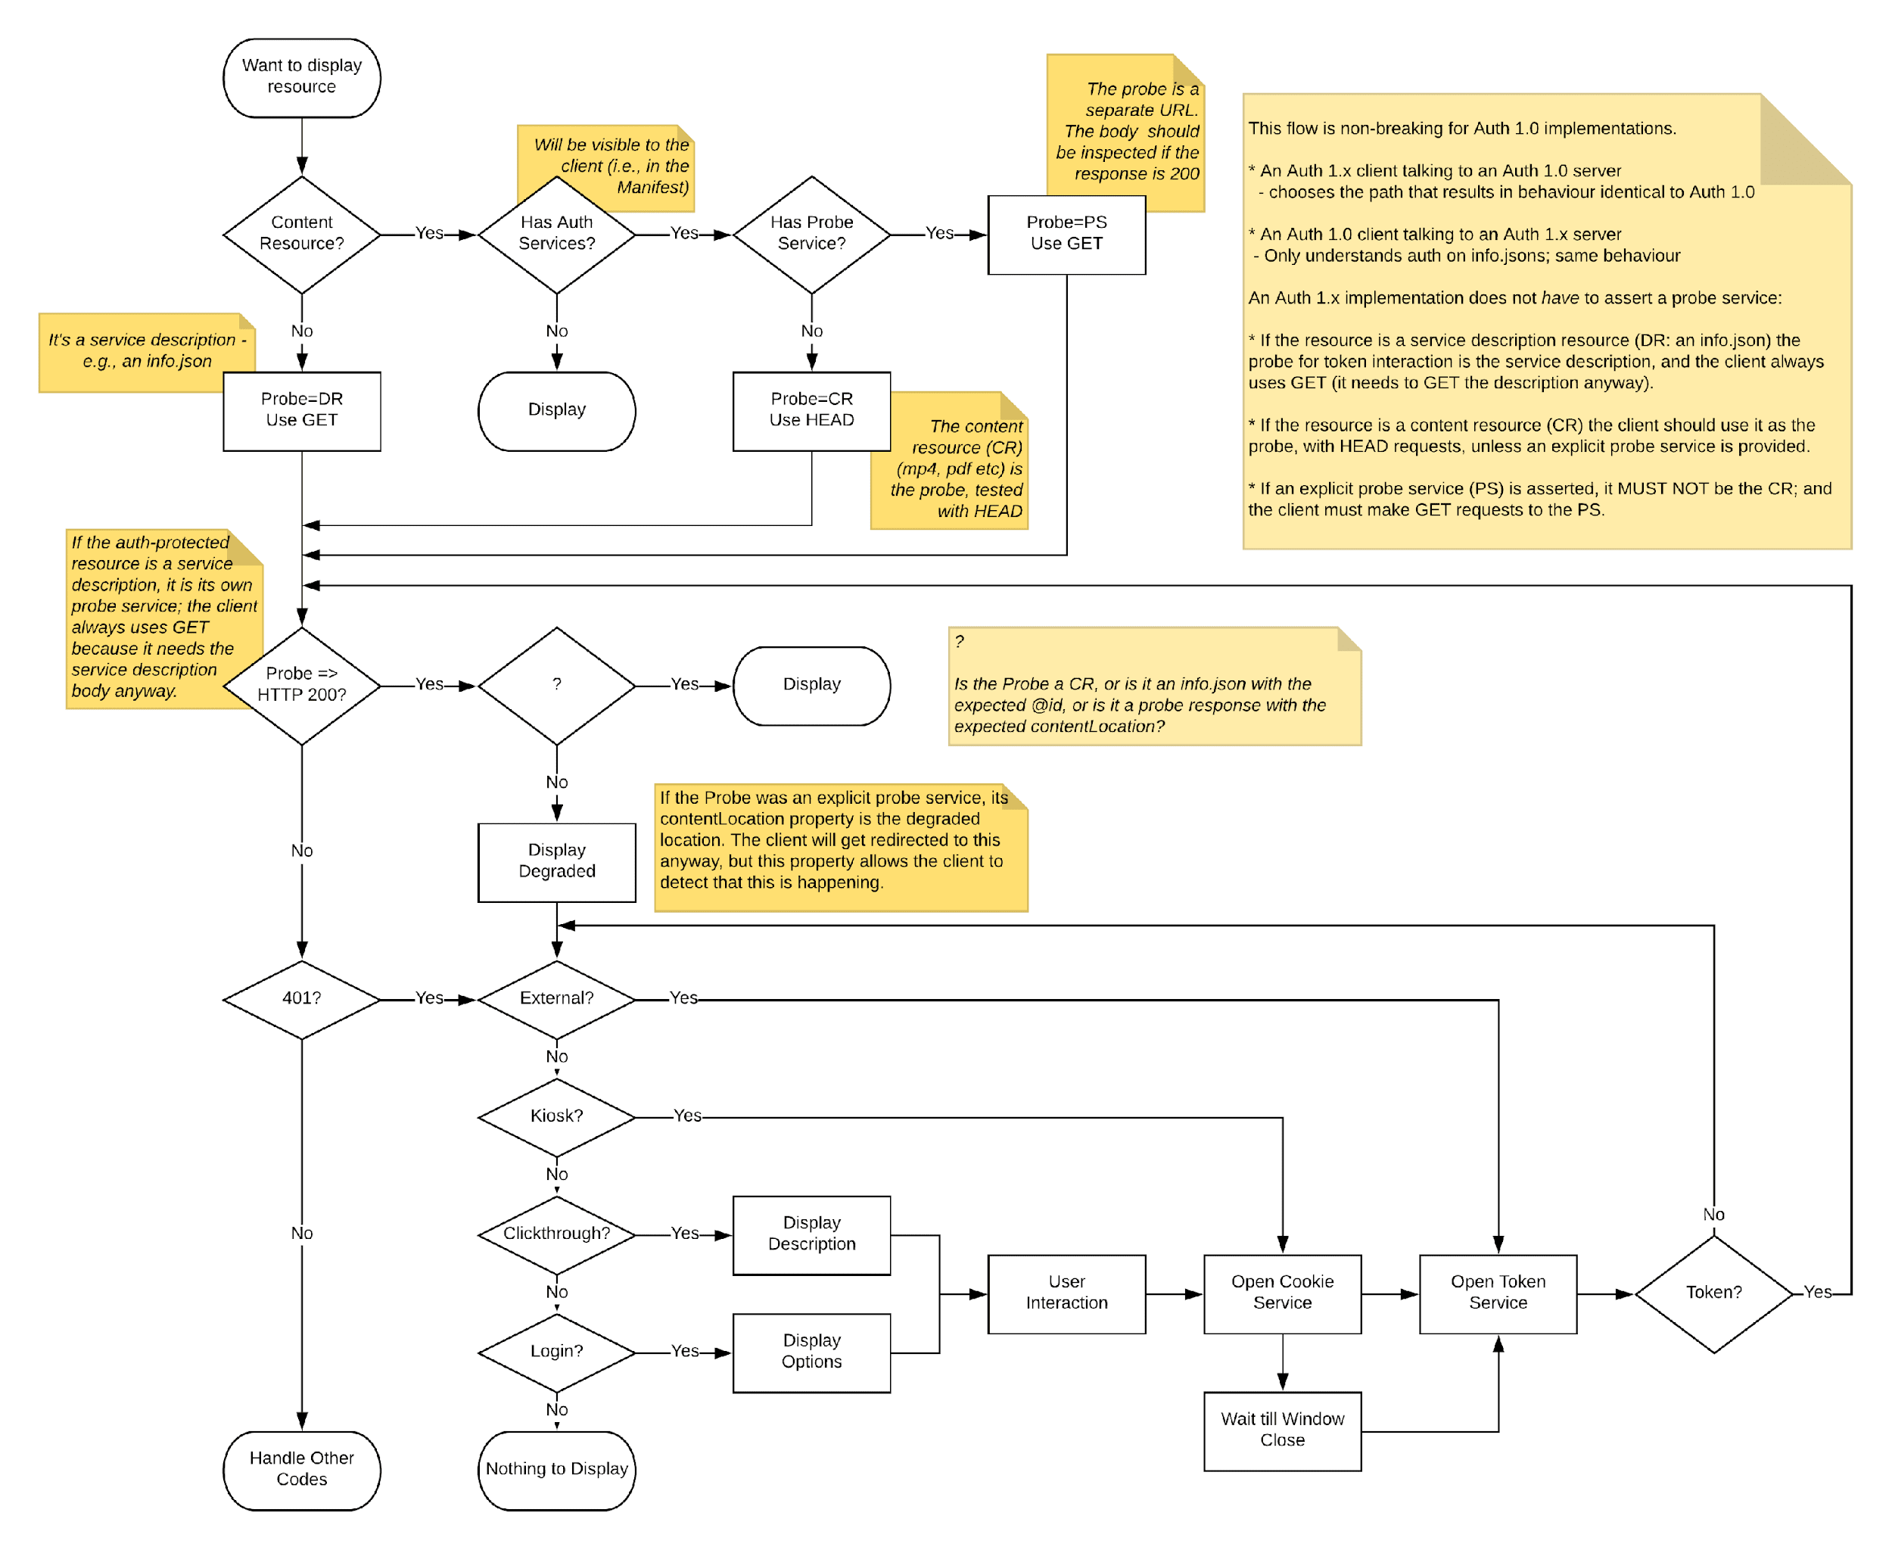
Notes:
IIIF defines a whole Authentication workflow to work with your existing solution
Either login, click through, kiosk or external (ie, completely up to you)
Allows you to present a degraded version
But then gives the user a clue that they are seeing a degraded version, and offer a resolution (in this case, logging in as staff)

Slide 31
Please can I see this content?
Just a straight yes/no

Slide 32
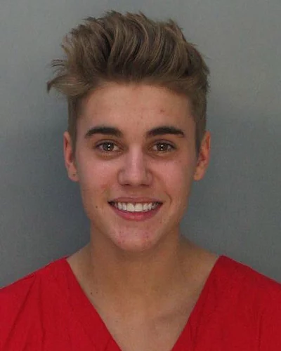
Please can I see this content?
“Degraded” workflow

Slide 33
Fine I will log in and/or move to Canada

Slide 34
Please can I see this content?
Having satisfied the requirements

Slide 35
Going further
Remember how everything is just an annotation?

Slide 36
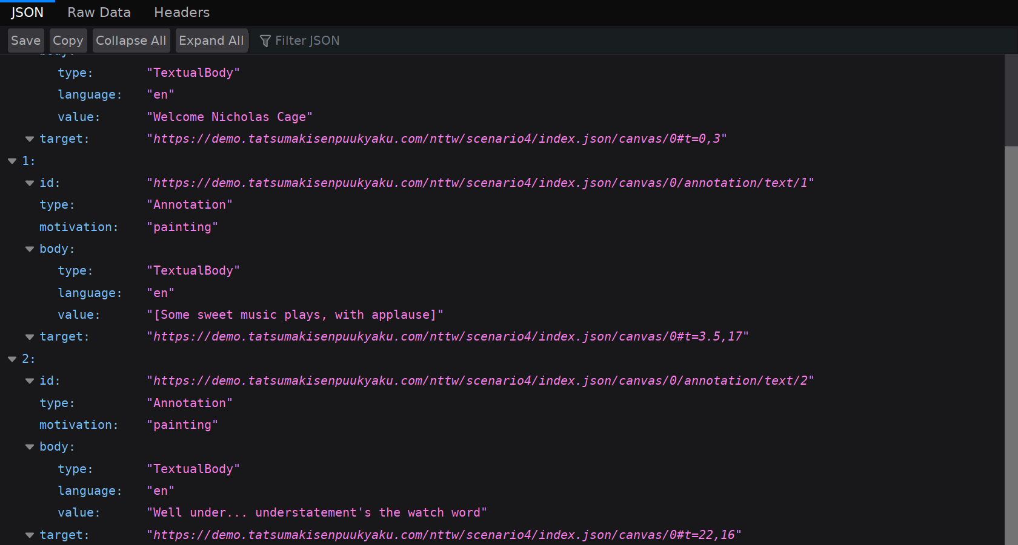
Notes:
With just a few lines of python (or some good cut & paste skills), you can turn those web vtt into web annotations. Use the same syntax to target the correct time range.
Why is this good?
You will be able to take advantage of the IIIF search API in the future! People can link to your transcription, provide translations, etc.

Slide 37
Notes:
Interoperability is cool!
Demo from McGil Univsity Montreal, https://ddmal.music.mcgill.ca/IIIF-AV-player/
Works by annotation Music Encoding Initiative source onto the canvas timeline
Which is rendered as an engraving and used to navigate

Slide 38
Notes:
This example from a hackathon held by the BBC and produced by Tom Crane and Joscher Jaeger
Tags the existing German parliamentary archive and makes it IIIF, replicating the interface.
One video annotated onto the canvas, and hundreds of text annotations.
The idea isn’t new, but the interoperability is
https://openhypervideo.github.io/iiif-interactive-transcript/

Slide 39
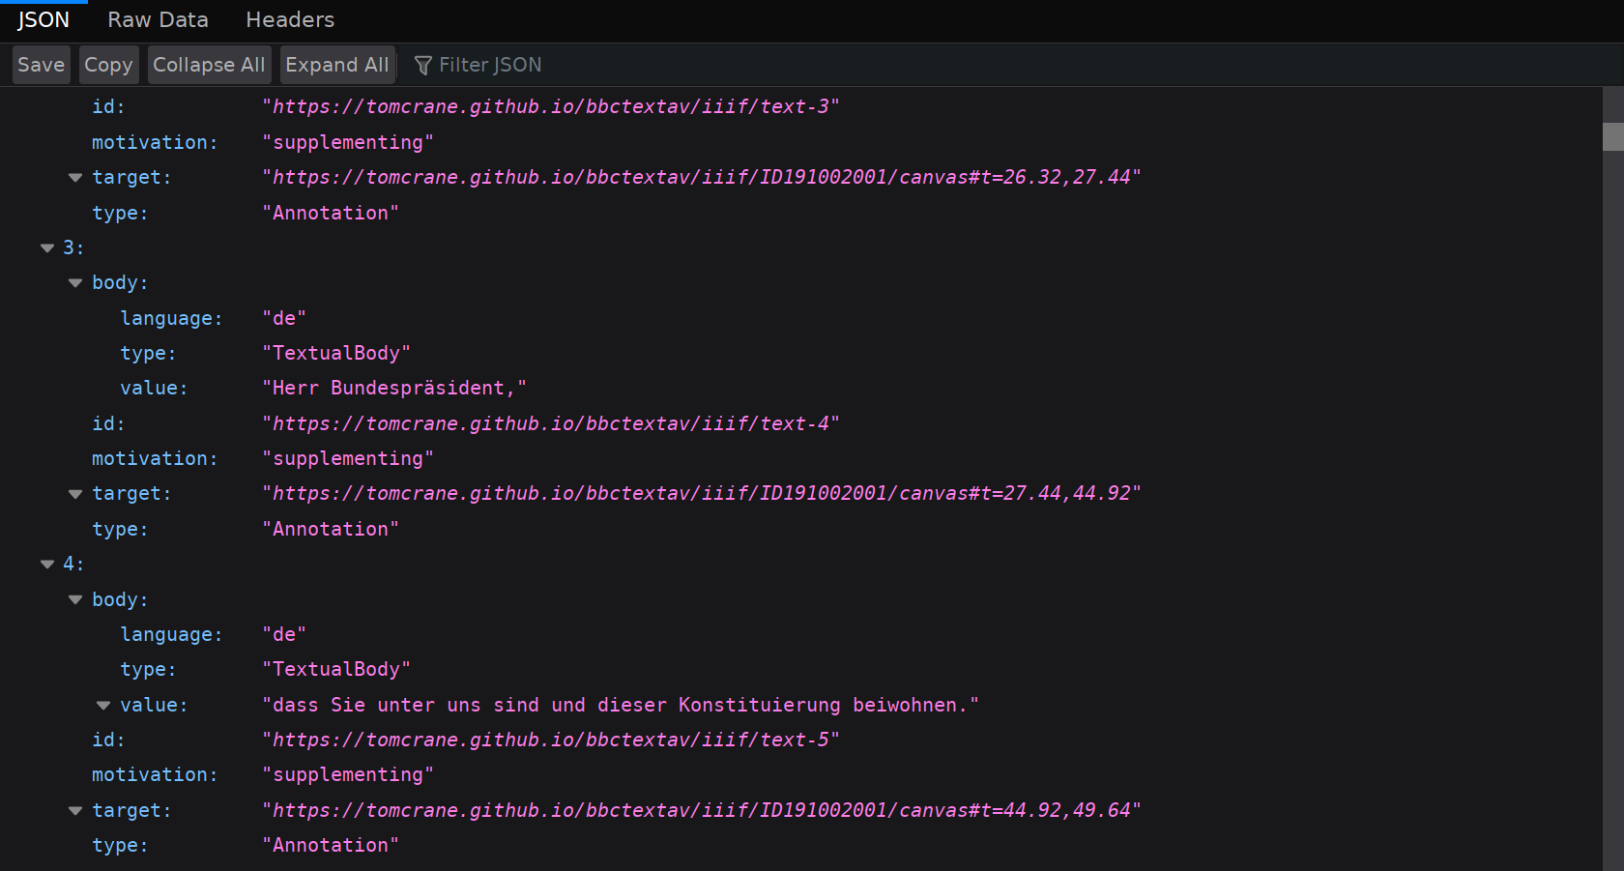

Slide 40
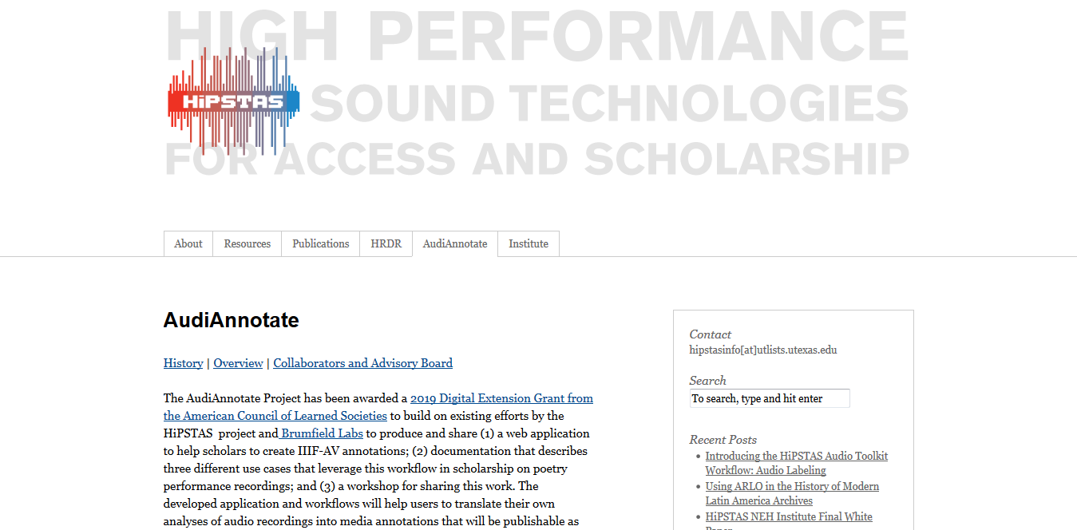
Notes:
Upcoming work from University of Texas/Brumfield labs on creating a workflow for annotating any AV content in IIIF

Slide 41
Please get involved!
https://iiif.io/
Join in the discussion group!
https://groups.google.com/forum/#!forum/iiif-discuss
Join the discussion on slack!
http://bit.ly/iiif-slack
Join in our bi-weekly community call
https://iiif.io/community/call

Slide 42
And in UV too!
Join the slack!
https://universalviewerinvite.herokuapp.com/
Sponsor the project!
https://opencollective.com/universalviewer
Or just feel free to help!
https://github.com/UniversalViewer/universalviewer

Slide 43
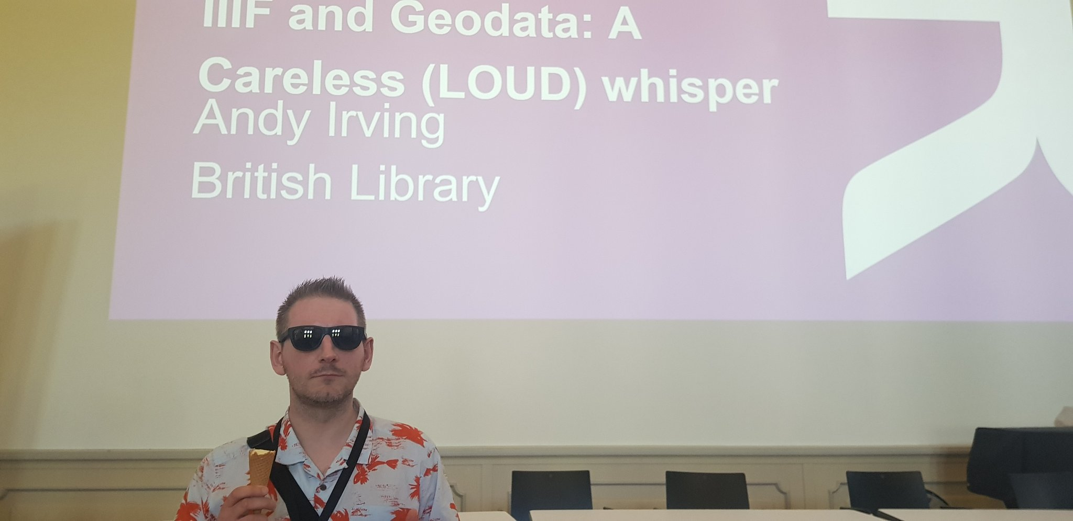
Thanks!
Questions?

